Slide 1
Green University of Bangladesh
Department of Computer Science & Engineering
Subject: Object Oriented programming
Course Code: CSE102
My Presentation topic :Artificial Intelligence
Submitted To:
Name : Ayesha Khatun
Designation : Lecturer
Department : CSE
Green University of Bangladesh
Submitted by:
Name :Jakirul Islam
ID :193002101
Department: CSE
Green University of Bangladesh

Slide 2
1
INDEX:
Definition
Future of AI
Applications of AI
Advantages & Disadvantages
Conclusion

Slide 3
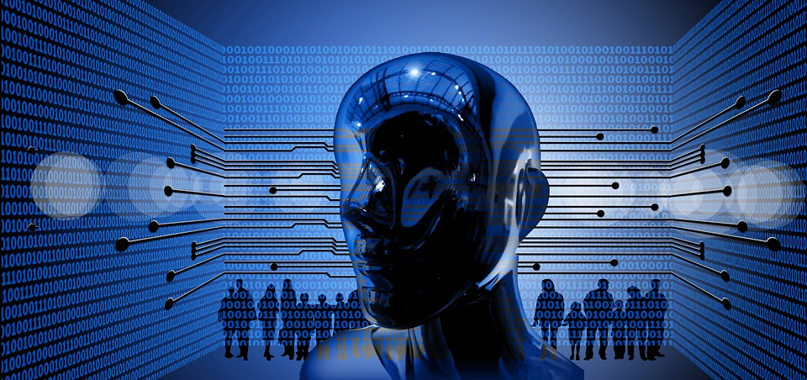
2
DEFINITION
Artificial intelligence ( AI ) is the intelligence of machines and the branch of computer science which aims to create it .
Artificial intelligence (AI) is the simulation of human intelligence by machines.
• The ability to solve problems
• The ability to act rationally
• The ability to act like humans

Slide 4
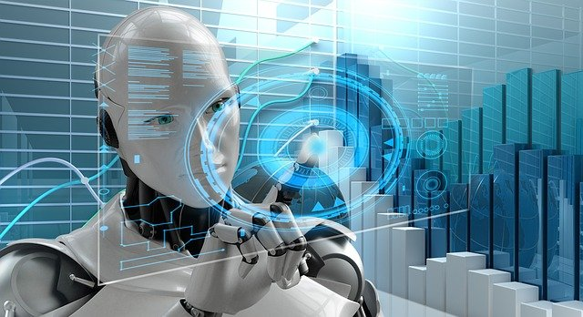

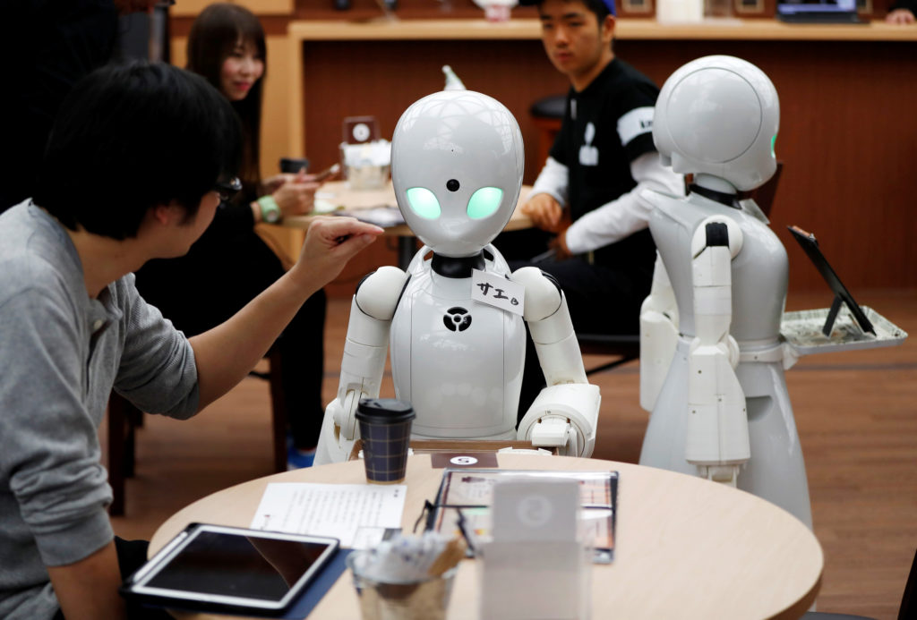
3
FUTURE OF AI
Beyond negotiation, Moore says CMU is betting several other AI areas are going to be hugely important in the near future.
Self Driving Cars.
Improved Medical Care & Treatment.
Open up doors to future explorations.

Slide 5
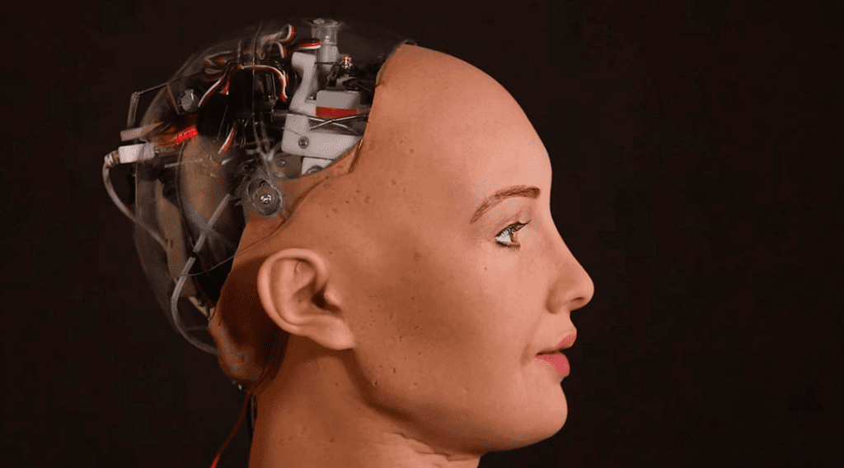
APPLICATIONS OF AI:
Natural Language Understanding
Expert Systems
Planning and Robotics
Machine Learning
Game Playing
4

Slide 6
5
ADVANTAGES
The chances of error are almost nil
It can be used to explore space.
Smartphones are greatest example of A.I.
It can be used in time consuming tasks efficiently
Algorithms can help the doctors asses patients and their health risks
Machines do not require sleep or break and are able to function without stopping

Slide 7
DISADVANTAGES
High cost
AI may be programmed to do something devastating
Machine Ethics
The storage and access are not as effective as human brains
No improvement with experience
6

Slide 8
CONCLUSION
Finally we can say that the Artificial Intelligence (AI) is the intelligence of machines and the branch of Computer Science that aims to create it.AI textbooks define the field as “ The Study and Design of Intelligent Agents” where an intelligent agent is a system that perceives it’s environment and takes actions that maximize the chances of it’s success. John McCarthy ,who coined the term in 1955, defines it as “The Science and Engineering of making intelligent Machines”
7

Slide 9
8
REFERENCES
http://en.wikibooks.org/wiki/Computer_Science:Artificial_Intelligence
http://www.howstuffworks.com/arificialintelligence
http://www.library.thinkquest.org

Slide 10
THANK YOU

